Slide 1
CHAPTER 2: Jakarta Servlet, Servlet Life cycle, Sharing Information
JAKARTA EE

Slide 2
CONTENT
21. Asynchronous Processing
2.2. Contexts and Dependency Injection (CDI)
2.3. REST API
2.4. JSP
2.5. Web Socket

Slide 3
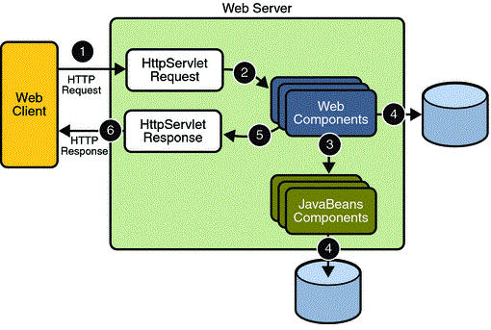
Terminologies
What is a Servlet?
A servlet is a Jakarta technology-based web component, managed by a container, that generates dynamic content.
Like other Jakarta technology-based components, servlets are platform-independent Java classes that are compiled to platform-neutral byte code that can be loaded dynamically into and run by a Jakarta technology-enabled web server.
Containers, sometimes called servlet engines, are web server extensions that provide servlet functionality. Servlets interact with web clients via a request/response paradigm implemented by the servlet container.

Slide 4
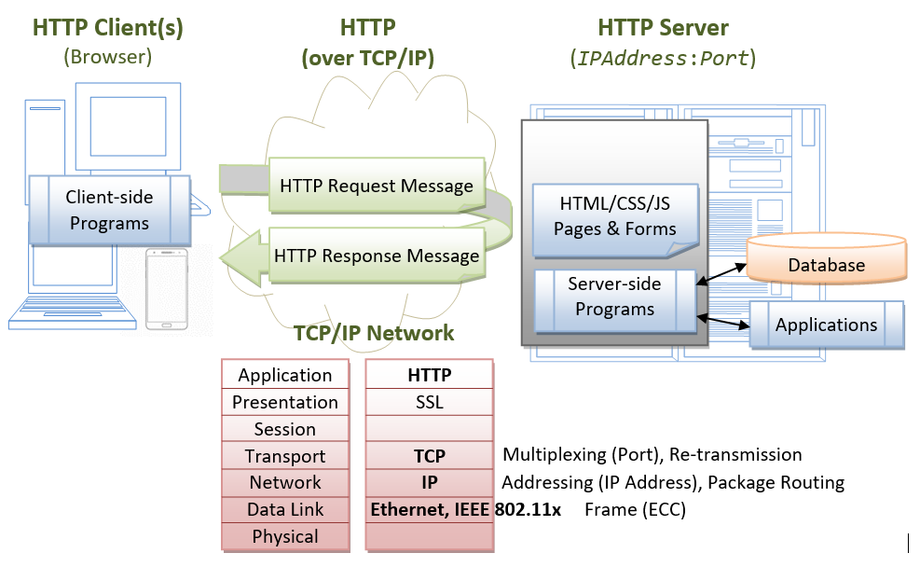
Servlet Request/Response Handling
Java Web Application Request Handling

Slide 5
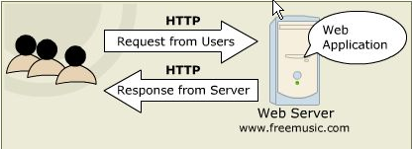
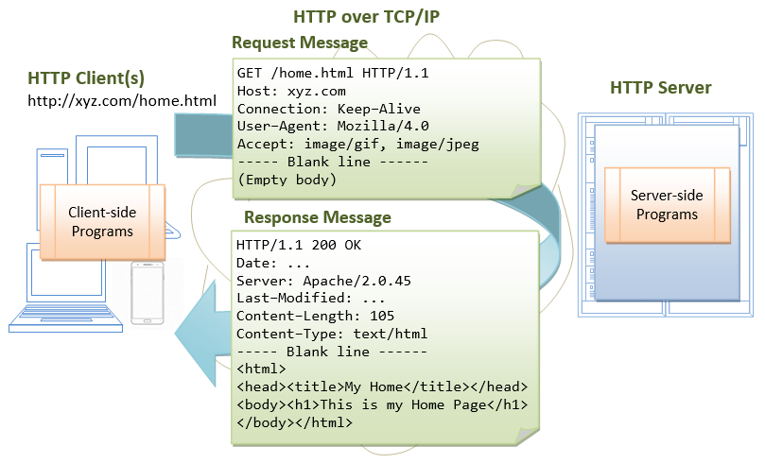
Servlet Communication & Protocols
Message
Notes:
https://www3.ntu.edu.sg/home/ehchua/programming/howto/Tomcat_HowTo.html

Slide 6
Http methods and Servlet methods
HTTP – Servlet methods mapping
Http method | Description | Servlet Method
GET | The GET method requests a representation of the specified resource. Requests using GET should only retrieve data. | doGet
POST | The POST method submits an entity to the specified resource, often causing a change in state or side effects on the server. | doPost
PUT | The PUT method replaces all current representations of the target resource with the request payload. | doPut
DELETE | The DELETE method deletes the specified resource. | doDelete
HEAD | The HEAD method asks for a response identical to a GET request, but without the response body. | doHead
OPTIONS | The OPTIONS method describes the communication options for the target resource. | doOptions
TRACE | The TRACE method performs a message loop-back test along the path to the target resource. | doTrace
CONNECT | The CONNECT method establishes a tunnel to the server identified by the target resource.
PATCH | The PATCH method applies partial modifications to a resource.

Slide 7
Terminologies
What is a Servlet Container?
The servlet container is a part of a web server or application server that provides the network services over which requests and responses are sent, decodes MIME-based requests, and formats MIME-based responses. A servlet container also contains and manages servlets through their lifecycle.
A servlet container can be built into a host web server or installed as an add-on component to a web server via that server’s native extension API. Servlet containers can also be built into or possibly installed into web-enabled application servers.
All servlet containers must support HTTP as a protocol for requests and responses, but additional request/response-based protocols such as HTTPS (HTTP over SSL) may be supported.

Slide 8
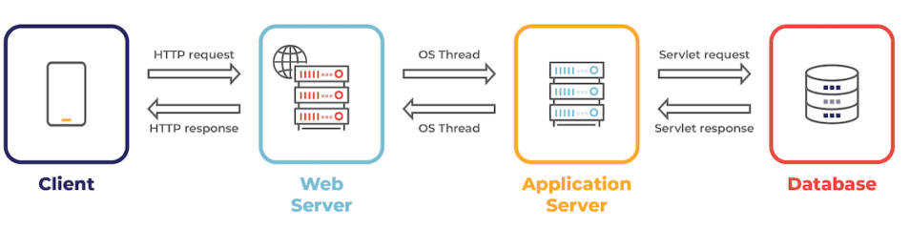
Terminologies
Java Web Server vs. Application Server
Web Server is a computer program that accepts the request for data and sends the specified documents. Web server may be a computer where the online content is kept. Essentially internet server is employed to host sites however there exist different web servers conjointly like recreation, storage, FTP, email, etc.
Application Server encompasses Web container as well as EJB container. Application servers organize the run atmosphere for enterprises applications. Application server may be a reasonably server that mean how to put operating system, hosting the applications and services for users, IT services and organizations. In this, user interface similarly as protocol and RPC/RMI protocols are used.

Slide 9
Web Server vs. Application Server
.NO | Web Server | Application Server
1. | Web server encompasses web container only. | While application server encompasses Web container as well as EJB container.
2. | Web server is useful or fitted for static content. | Whereas application server is fitted for dynamic content.
3. | Web server consumes or utilizes less resources. | While application server utilize more resources.
4. | Web servers arrange the run environment for web applications. | While application servers arrange the run environment for enterprises applications.
5. | In web servers, multithreading is supported. | While in application server, multithreading is not supported.
6. | Web server’s capacity is lower than application server. | While application server’s capacity is higher than web server.
7. | In web server, HTML and HTTP protocols are used. | While in this, GUI as well as HTTP and RPC/RMI protocols are used.
8. | Processes that are not resource-intensive are supported. | Processes that are resource-intensive are supported.
9. | Transactions and connection pooling is not supported. | Transactions and connection pooling is supported.
10. | The capacity of fault tolerance is low as compared to application servers. | It has high fault tolerance.
11. | Web Server examples are Apache HTTP Server , Tomcat, Jetty, Nginx,... | Application Servers example are JBoss EAP, WildFly, Glassfish, Apache TomEE, IBM Websphere,….

Slide 10

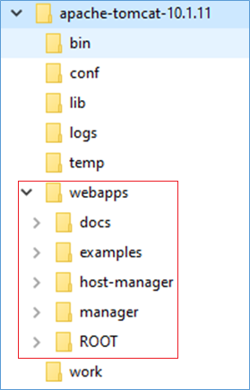
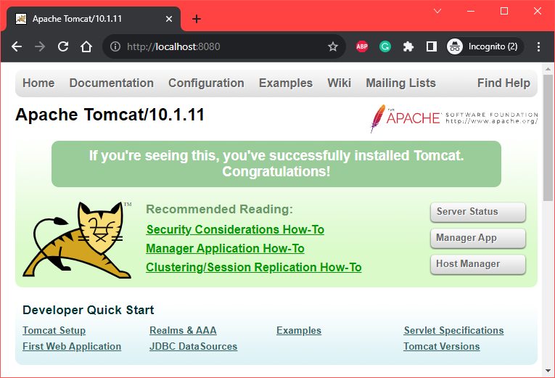
Apache Tomcat Web Server
Download: https://tomcat.apache.org/download-10.cgi (v 10.1.11 or higher)
Configuration:
Install JDK (8/11/17), add to PATH environment
Edit: .\conf\tomcat-user.xml
Start Tomcat: .\bin\startup.bat

Slide 11
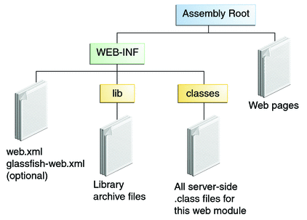
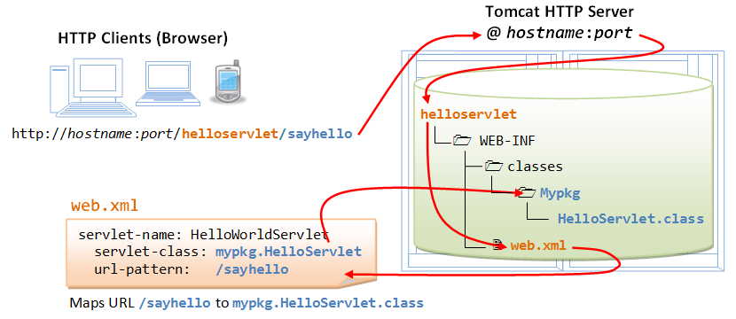
Development
Web Application Directory Structure
Create directory structure
Put resources into these folders appropriately
Copy it to webapps folder of Tomcat web server
→ automatically deploy
Fig1. Java web-application Structure
Fig2: Sample application

Slide 12
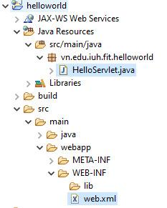
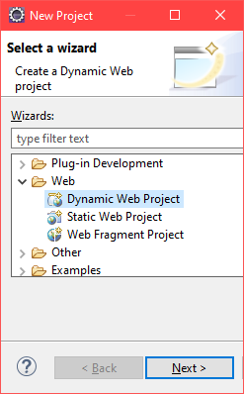
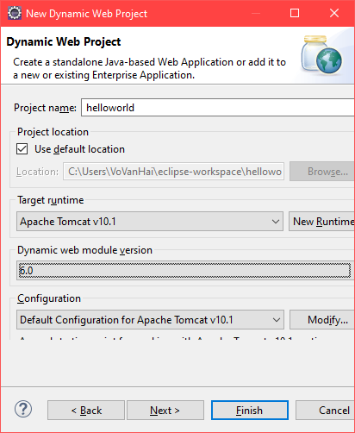
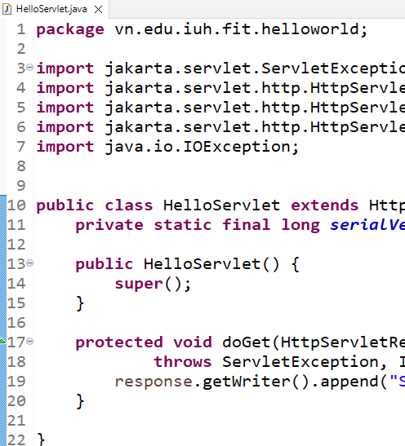
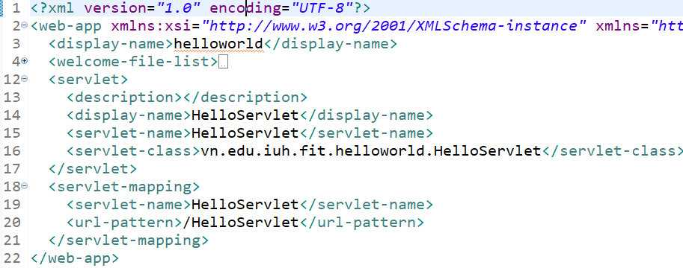
Create Application
With Eclipse

Slide 13
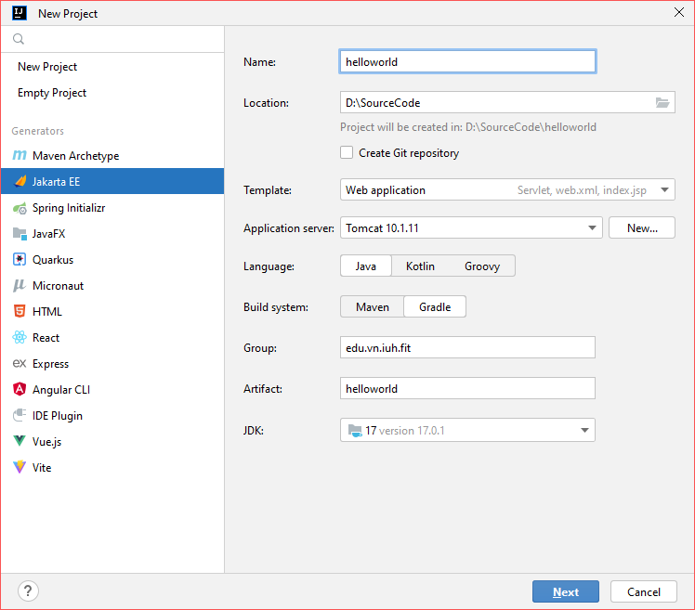
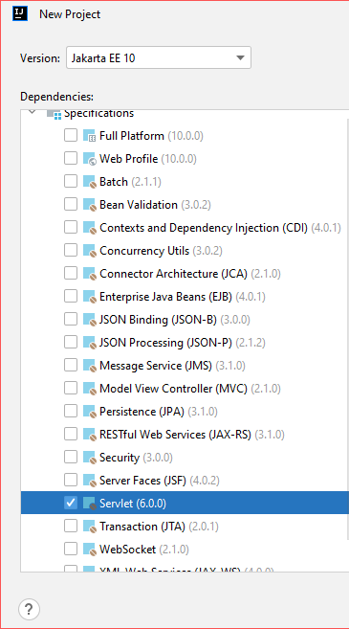
Create Application
With IntelliJ IDEA

Slide 14
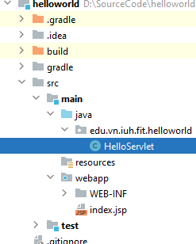
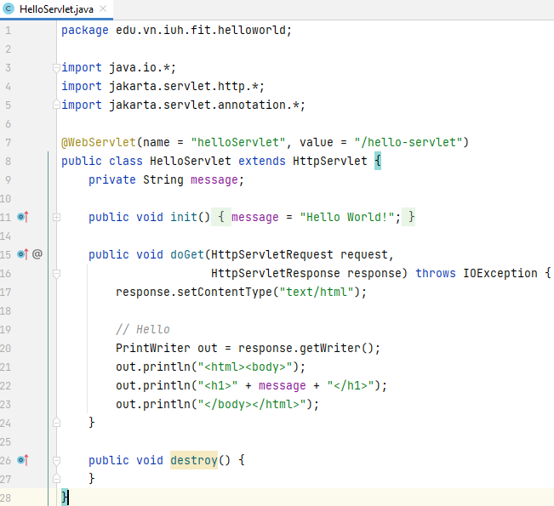
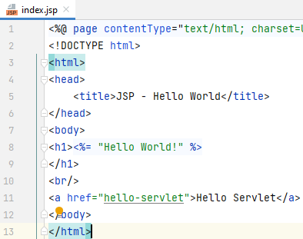
Sample Servlet

Slide 15

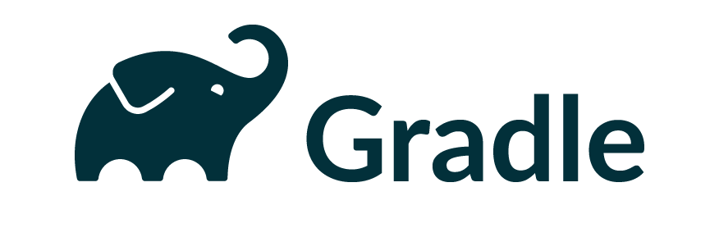

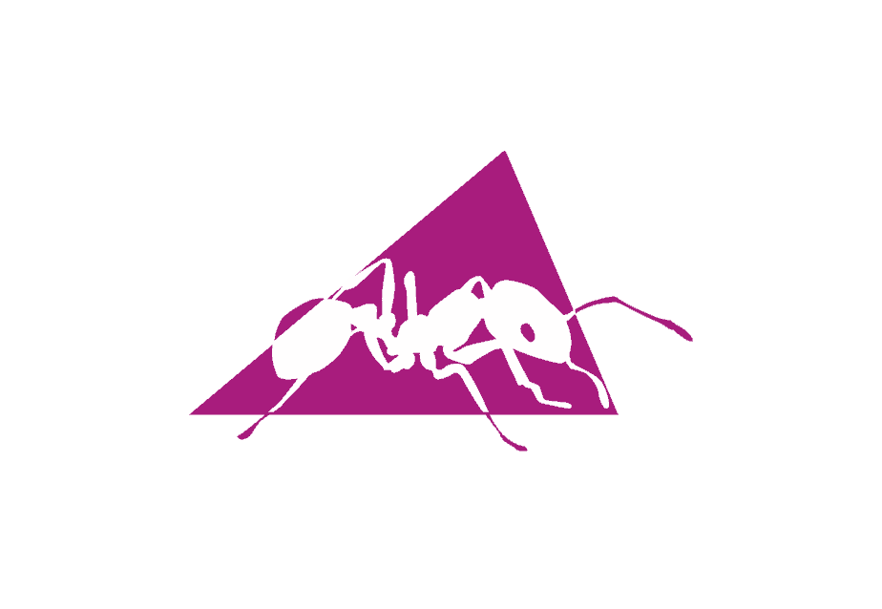
Create Project with Build tools
Maven:
<dependency> <groupId>jakarta.servlet</groupId> <artifactId>jakarta.servlet-api</artifactId> <version>6.0.0</version> </dependency>
Gradle:
compileOnly('jakarta.servlet:jakarta.servlet-api:6.0.0')

Slide 16
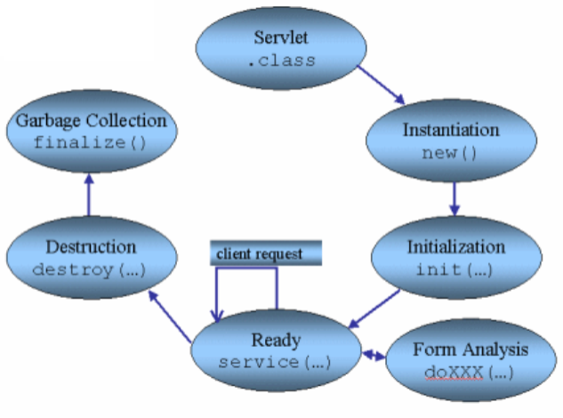
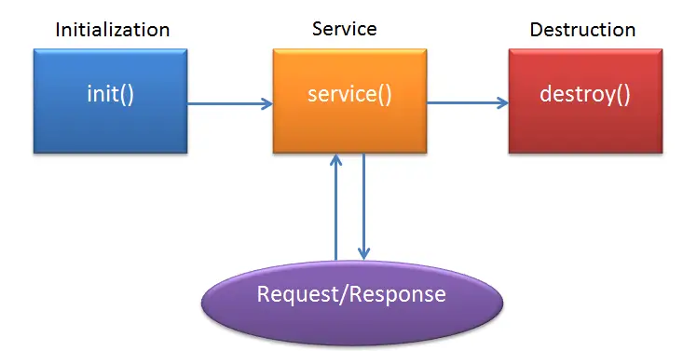
Jakarta Servlet Life Cycle
Generic Servlet Life Cycle
The life cycle is defined by:
init() – called only one by the server in the first request
service() – process the client’s request
destroy() – called after all requests have been processed or a server-specific number of seconds have passed
Source
Fig: The Servlet Life Cycle
Source

Slide 17
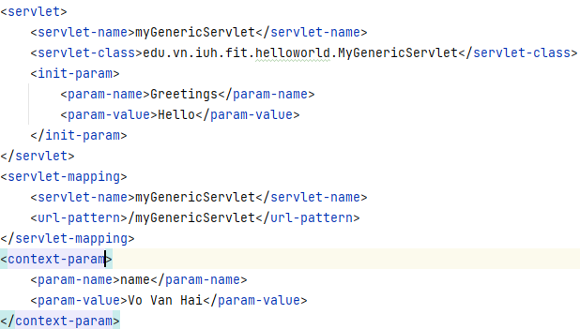
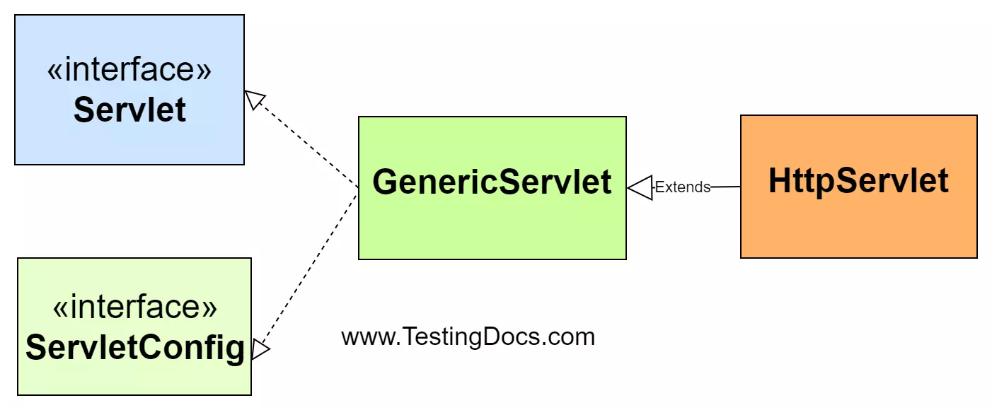
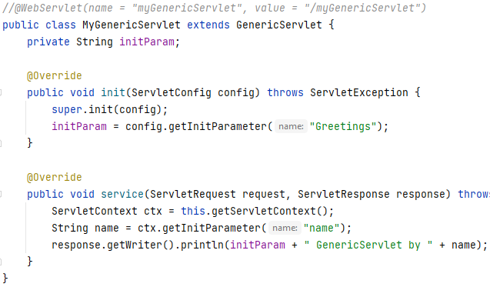
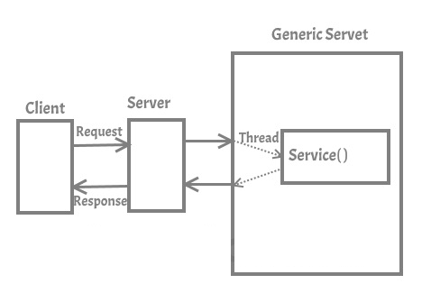

Types of Servlet
The jakarta.servlet.GenericServlet

Slide 18
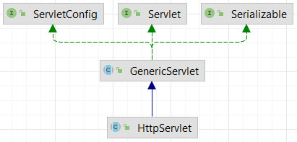
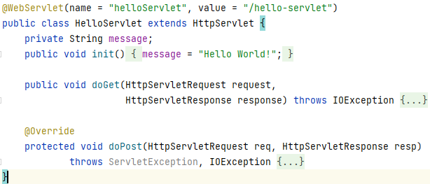
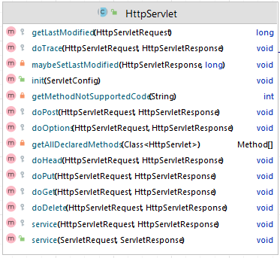
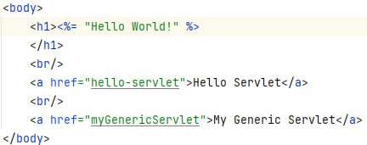
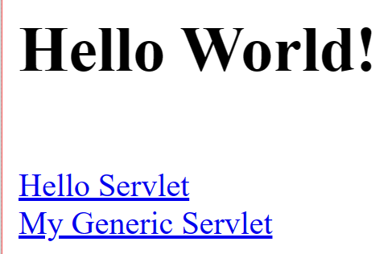
Types of Servlet
jakarta.servlet.http.HttpServlet

Slide 19

Handling Servlet Lifecycle Events
You can monitor and react to events in a servlet’s lifecycle by defining listener objects whose methods get invoked when lifecycle events occur.
Servlet Lifecycle Events
Object | Event | Listener Interface and Event Class
Web context | Initialization and destruction | jakarta.servlet.ServletContextListener and ServletContextEvent
Web context | Attribute added, removed, or replaced | jakarta.servlet.ServletContextAttributeListener and ServletContextAttributeEvent
Session | Creation, invalidation, activation, passivation, and timeout | jakarta.servlet.http.HttpSessionListener, jakarta.servlet.http.HttpSessionActivationListener, and HttpSessionEvent
Session | Attribute added, removed, or replaced | jakarta.servlet.http.HttpSessionAttributeListener and HttpSessionBindingEvent
Request | A servlet request has started being processed by web components | jakarta.servlet.ServletRequestListener and ServletRequestEvent
Request | Attribute added, removed, or replaced | jakarta.servlet.ServletRequestAttributeListener and ServletRequestAttributeEvent

Slide 20
Sharing Information
Using Scope Objects
Collaborating web components share information by means of objects that are maintained as attributes of four scope objects. You access these attributes by using the getAttribute and setAttribute methods of the class representing the scope.
Scope Object | Class | Accessible From
Web context | jakarta.servlet.ServletContext | Web components within a web context. See [accessing-the-web-context]. | // set/get application scoped attribute req.getServletContext().setAttribute("name", "application scoped attribute"); String applicationScope = (String) req.getServletContext().getAttribute("a");
Session | jakarta.servlet.http.HttpSession | Web components handling a request that belongs to the session. See [maintaining-client-state]. | // set/get session scoped attribute HttpSession session = req.getSession(); session.setAttribute("name", "session scoped attribute"); String sessionScope = (String) session.getAttribute("b");
Request | Subtype of jakarta.servlet.ServletRequest | Web components handling the request. | // set/get request scoped attribute req.setAttribute("name", "request scoped attribute"); String requestScope = (String) req.getAttribute("c"); // send redirect to other servlet req.getRequestDispatcher("get-attributes").forward(req, resp);
Page | jakarta.servlet.jsp.JspContext | The Jakarta Server Pages page that creates the object. | <% page.setAttribute("name","page scoped attribute"); String pageStr = page.getAttribute("name").toString(); %>

Slide 21
Sharing Information
Controlling Concurrent Access to Shared Resources
In a multithreaded server, shared resources can be accessed concurrently. In addition to scope object attributes, shared resources include in-memory data, such as instance or class variables, and external objects, such as files, database connections, and network connections.
Concurrent access can arise in several situations.
Multiple web components accessing objects stored in the web context.
Multiple web components accessing objects stored in a session.
Multiple threads within a web component accessing instance variables.
A web container will typically create a thread to handle each request. To ensure that a servlet instance handles only one request at a time, a servlet can implement the SingleThreadModel interface. If a servlet implements this interface, no two threads will execute concurrently in the servlet’s service method. A web container can implement this guarantee by synchronizing access to a single instance of the servlet or by maintaining a pool of web component instances and dispatching each new request to a free instance. This interface does not prevent synchronization problems that result from web components' accessing shared resources, such as static class variables or external objects.

Slide 22
Asynchronous Processing
Introduction
Web containers in application servers normally use a server thread per client request.
Under heavy load conditions, containers need a large amount of threads to serve all the client requests.
Scalability limitations include running out of memory or exhausting the pool of container threads.
To create scalable web applications, you must ensure that no threads associated with a request are sitting idle, so the container can use them to process new requests.
There are two common scenarios in which a thread associated with a request can be sitting idle:
The thread needs to wait for a resource to become available or process data before building the response. For example, an application may need to query a database or access data from a remote web service before generating the response.
The thread needs to wait for an event before generating the response. For example, an application may have to wait for a Jakarta Messaging message, new information from another client, or new data available in a queue before generating the response.

Slide 23

Asynchronous Processing
Asynchronous Processing in Servlets
To enable asynchronous processing on a servlet, set the parameter asyncSupported to true on the @WebServlet annotation as follows:
The jakarta.servlet.AsyncContext class provides the functionality that you need to perform asynchronous processing inside service methods. To obtain an instance of AsyncContext, call the startAsync() method on the request object of your service method;
The AsyncListener class provides the functionality that you can use to listen the states of async thread.
public class MyAsyncListener implements AsyncListener {
//…
}

Slide 24
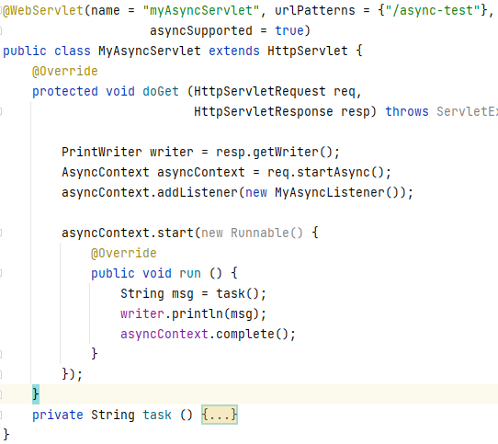
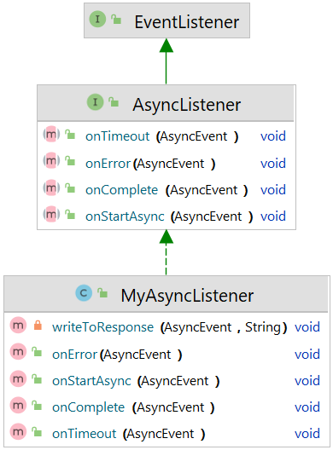
Asynchronous Processing
Example
Read more: https://github.com/eclipse-ee4j/jakartaee-tutorial/blob/master/src/main/asciidoc/servlets/servlets012.adoc
Notes:
package edu.vn.iuh.fit.async; import jakarta.servlet.AsyncContext; import jakarta.servlet.ServletException; import jakarta.servlet.annotation.WebServlet; import jakarta.servlet.http.*; import java.io.IOException; import java.io.PrintWriter; import java.util.concurrent.ThreadLocalRandom; @WebServlet(name = "myAsyncServlet", urlPatterns = {"/async-test"}, asyncSupported = true) public class MyAsyncServlet extends HttpServlet { @Override protected void doGet (HttpServletRequest req, HttpServletResponse resp) throws ServletException, IOException { PrintWriter writer = resp.getWriter(); AsyncContext asyncContext = req.startAsync(); asyncContext.addListener(new MyAsyncListener()); asyncContext.start(new Runnable() { @Override public void run () { String msg = task(); writer.println(msg); asyncContext.complete(); } }); } private String task () { long start = System.currentTimeMillis(); try { int i = ThreadLocalRandom.current() .nextInt(1, 5); Thread.sleep(i * 1000); } catch (InterruptedException e) { e.printStackTrace(); } return "time to complete long task " + (System.currentTimeMillis() - start); } }

Slide 25

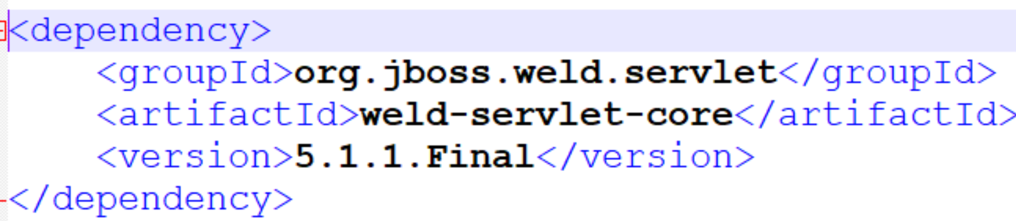
Contexts and Dependency Injection (CDI)
Introduction
CDI (Contexts and Dependency Injection) is a standard dependency injection framework included in Java EE 6 and higher.
It allows us to manage the lifecycle of stateful components via domain-specific lifecycle contexts and inject components (services) into client objects in a type-safe way
CDI
Contexts: The ability to bind the lifecycle and interactions of stateful components to well-defined but extensible lifecycle contexts
Dependency injection: The ability to inject components into an application in a type-safe way, including the ability to choose at deployment time which implementation of a particular interface to inject.
In Tomcat Server, it’s needed to add reference to jboss weld dependency
Read more:
https://github.com/eclipse-ee4j/jakartaee-tutorial/tree/master/src/main/asciidoc/cdi-basic
Notes:
implementation 'org.jboss.weld.servlet:weld-servlet-core:5.1.1.Final'

Slide 26
REST API

Slide 27
RESTful Web Services
Introduction
RESTful web services are loosely coupled, lightweight web services that are particularly well suited for creating APIs for clients spread out across the internet.
Representational State Transfer (REST) is an architectural style of client-server application centered around the transfer of representations of resources through requests and responses.
In the REST architectural style, data and functionality are considered resources and are accessed using Uniform Resource Identifiers (URIs), typically links on the Web.
The resources are represented by documents and are acted upon by using a set of simple, well-defined operations.

Slide 28
RESTful Root Resource
Developing RESTful Web Services with Jakarta REST
Jakarta REST is a Java programming language API designed to make it easy to develop applications that use the REST architecture.
The Jakarta REST API uses Java programming language annotations to simplify the development of RESTful web services.
Developers decorate Java programming language class files with Jakarta REST annotations to define resources and the actions that can be performed on those resources.
Jakarta REST Annotations
@Path | @PATCH | @Consumes
@GET | @HEAD | @Produces
@POST | @OPTIONS | @Provider
@PUT | @PathParam | @ApplicationPath
@DELETE | @QueryParam
https://github.com/eclipse-ee4j/jakartaee-tutorial/blob/master/src/main/asciidoc/jaxrs/jaxrs002.adoc
Notes:
AnnotationDescription
@Path
The @Path annotation’s value is a relative URI path indicating where the Java class will be hosted: for example, /helloworld. You can also embed variables in the URIs to make a URI path template. For example, you could ask for the name of a user and pass it to the application as a variable in the URI: /helloworld/{username}.
@GET
The @GET annotation is a request method designator and corresponds to the similarly named HTTP method. The Java method annotated with this request method designator will process HTTP GET requests. The behavior of a resource is determined by the HTTP method to which the resource is responding.
@POST
The @POST annotation is a request method designator and corresponds to the similarly named HTTP method. The Java method annotated with this request method designator will process HTTP POST requests. The behavior of a resource is determined by the HTTP method to which the resource is responding.
@PUT
The @PUT annotation is a request method designator and corresponds to the similarly named HTTP method. The Java method annotated with this request method designator will process HTTP PUT requests. The behavior of a resource is determined by the HTTP method to which the resource is responding.
@DELETE
The @DELETE annotation is a request method designator and corresponds to the similarly named HTTP method. The Java method annotated with this request method designator will process HTTP DELETE requests. The behavior of a resource is determined by the HTTP method to which the resource is responding.
@HEAD
The @HEAD annotation is a request method designator and corresponds to the similarly named HTTP method. The Java method annotated with this request method designator will process HTTP HEAD requests. The behavior of a resource is determined by the HTTP method to which the resource is responding.
@OPTIONS
The @OPTIONS annotation is a request method designator and corresponds to the similarly named HTTP method. The Java method annotated with this request method designator will process HTTP OPTIONS requests. The behavior of a resource is determined by the HTTP method to which the resource is responding.
@PATCH
The @PATCH annotation is a request method designator and corresponds to the similarly named HTTP method. The Java method annotated with this request method designator will process HTTP PATCH requests. The behavior of a resource is determined by the HTTP method to which the resource is responding.
@PathParam
The @PathParam annotation is a type of parameter that you can extract for use in your resource class. URI path parameters are extracted from the request URI, and the parameter names correspond to the URI path template variable names specified in the @Path class-level annotation.
@QueryParam
The @QueryParam annotation is a type of parameter that you can extract for use in your resource class. Query parameters are extracted from the request URI query parameters.
@Consumes
The @Consumes annotation is used to specify the MIME media types of representations a resource can consume that were sent by the client.
@Produces
The @Produces annotation is used to specify the MIME media types of representations a resource can produce and send back to the client: for example, "text/plain".
@Provider
The @Provider annotation is used for anything that is of interest to the Jakarta REST runtime, such as MessageBodyReader and MessageBodyWriter. For HTTP requests, the MessageBodyReader is used to map an HTTP request entity body to method parameters. On the response side, a return value is mapped to an HTTP response entity body by using a MessageBodyWriter. If the application needs to supply additional metadata, such as HTTP headers or a different status code, a method can return a Response that wraps the entity and that can be built using Response.ResponseBuilder.
@ApplicationPath
The @ApplicationPath annotation is used to define the URL mapping for the application. The path specified by @ApplicationPath is the base URI for all resource URIs specified by @Path annotations in the resource class. You may only apply @ApplicationPath to a subclass of jakarta.ws.rs.core.Application.

Slide 29
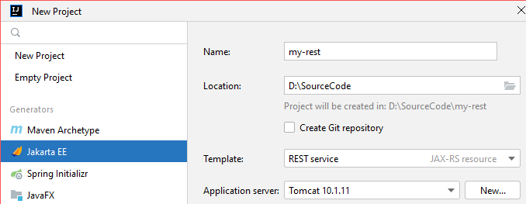
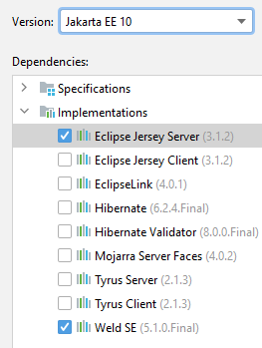
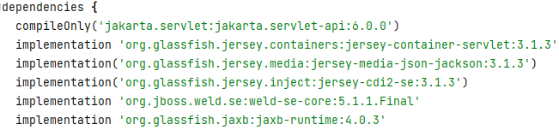
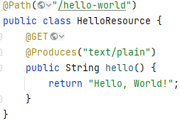

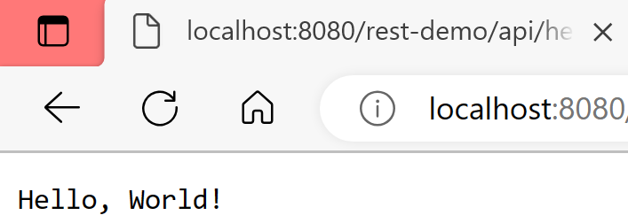
REST - example
http://localhost:8080/rest-demo/api/hello-world
Notes:
compileOnly('jakarta.servlet:jakarta.servlet-api:6.0.0') implementation ('jakarta.platform:jakarta.jakartaee-web-api:10.0.0') implementation 'org.glassfish.jersey.containers:jersey-container-servlet:3.1.3' implementation('org.glassfish.jersey.media:jersey-media-json-jackson:3.1.3') implementation('org.glassfish.jersey.inject:jersey-cdi2-se:3.1.3') implementation 'org.jboss.weld.se:weld-se-core:5.1.1.Final' implementation 'com.fasterxml.jackson.module:jackson-module-jaxb-annotations:2.15.2' implementation 'jakarta.xml.bind:jakarta.xml.bind-api:4.0.0' implementation 'org.glassfish.jaxb:jaxb-runtime:4.0.3' implementation 'javax.xml.bind:jaxb-api:2.3.1'

Slide 30
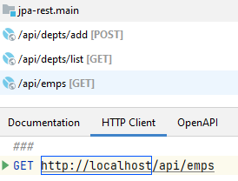
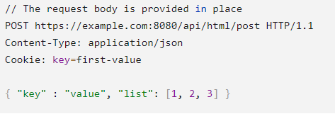
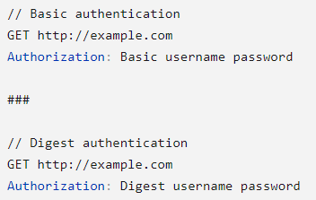
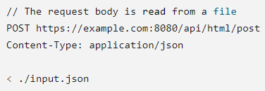



REST API Client
https://www.jetbrains.com/help/idea/exploring-http-syntax.html
In IDEA environment, select View menu --> Tool Windows --> Enpoints

Slide 31
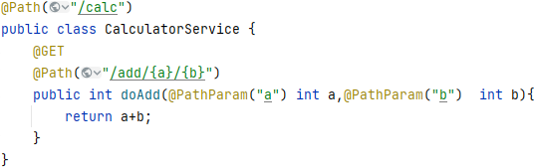
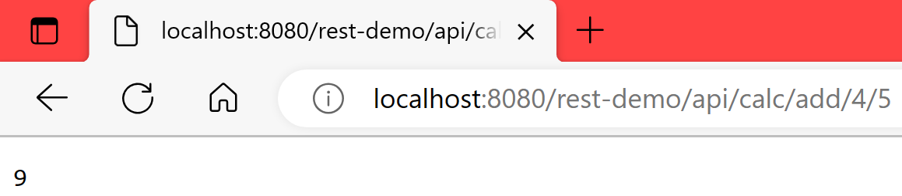
REST
The @Path Annotation and URI Path Templates
The @Path annotation identifies the URI path template to which the resource responds and is specified at the class or method level of a resource.
The @Path annotation’s value is a partial URI path template relative to the base URI of the server on which the resource is deployed, the context root of the application, and the URL pattern to which the Jakarta REST runtime responds.
URI path templates are URIs with variables embedded within the URI syntax. These variables are substituted at runtime in order for a resource to respond to a request based on the substituted URI. Variables are denoted by braces ({ and }).

Slide 32
REST
Types Supported for HTTP Request and Response Entity Bodies
Using Entity Providers to Map HTTP Response and Request Entity Bodies
Entity providers supply mapping services between representations and their associated Java types.
The two types of entity providers are MessageBodyReader and MessageBodyWriter.
Java Type | Supported Media Types
byte[] | All media types (*/*)
java.lang.String | All text media types (text/*)
java.io.InputStream | All media types (*/*)
java.io.Reader | All media types (*/*)
java.io.File | All media types (*/*)
jakarta.activation.DataSource | All media types (*/*)
javax.xml.transform.Source | XML media types (text/xml, application/xml, and application/*+xml)
jakarta.xml.bind.JAXBElement and application-supplied Jakarta XML Binding classes | XML media types (text/xml, application/xml, and application/*+xml)
MultivaluedMap<String, String> | Form content (application/x-www-form-urlencoded)
StreamingOutput | All media types (/), MessageBodyWriter only

Slide 33
REST
Using @Consumes and @Produces to Customize Requests and Responses
The value of @Produces is an array of String of MIME types or a comma-separated list of MediaType constants. For example:
@Produces({"image/jpeg,image/png"})
@Produces(MediaType.APPLICATION_XML)
@Produces({"application/xml", "application/json"})
The @Consumes annotation is used to specify which MIME media types of representations a resource can accept, or consume, from the client.
If @Consumes is applied at the class level, all the response methods accept the specified MIME types by default.
If applied at the method level, @Consumes overrides any @Consumes annotations applied at the class level.
Example:
@Consumes({"text/plain,text/html"})
@Consumes({MediaType.TEXT_PLAIN,MediaType.TEXT_HTML})
@Consumes("multipart/related")
@Consumes("application/x-www-form-urlencoded")

Slide 34
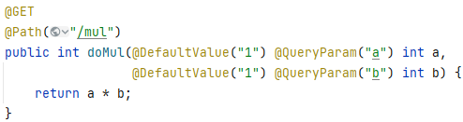
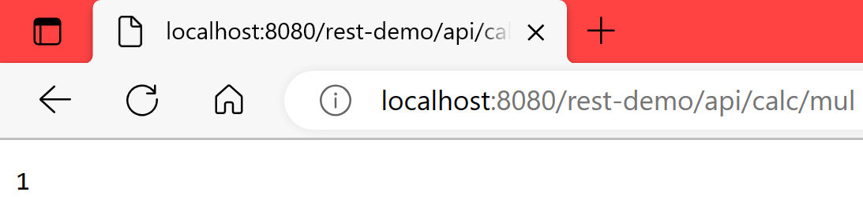
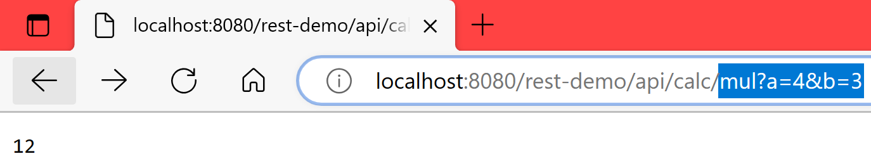
REST
Extracting Request Parameters
Parameters of a resource method may be annotated with parameter-based annotations to extract information from a request. A previous example presented the use of the @PathParam parameter to extract a path parameter from the path component of the request URL that matched the path declared in @Path.
You can extract the following types of parameters for use in your resource class: Query, URI path, Form, Cookie, Header, Matrix

Slide 35
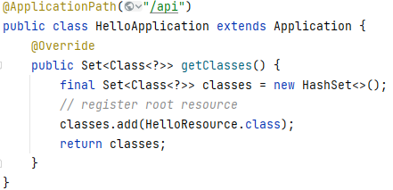
REST
Configuring Jakarta REST Applications
Create a subclass of jakarta.ws.rs.core.Application to manually configure the environment in which the REST resources defined in your resource classes are run, including the base URI. Add a class-level @ApplicationPath annotation to set the base URI.
@ApplicationPath("/api") public class HelloApplication extends Application {}
→all resources defined within the application are relative to /api
By default, all the resources in an archive will be processed for resources. Override the getClasses method to manually register the resource classes in the application with the Jakarta REST runtime.

Slide 36

REST Client
Notes:
//for client implementation('org.glassfish.jersey.core:jersey-client:3.0.4') implementation('org.glassfish.jersey.media:jersey-media-json-jackson:3.1.3') implementation 'org.glassfish.jersey.inject:jersey-hk2:3.1.3'

Slide 37

REST Client
Get a list of Java object
Notes:
package vn.edu.iuh.fit.client; import com.fasterxml.jackson.core.JsonProcessingException; import com.fasterxml.jackson.core.type.TypeReference; import com.fasterxml.jackson.databind.ObjectMapper; import jakarta.ws.rs.client.Client; import jakarta.ws.rs.client.ClientBuilder; import jakarta.ws.rs.client.WebTarget; import jakarta.ws.rs.core.MediaType; import vn.edu.iuh.fit.models.Student; import java.util.List; public class DriverClass { public static void main(String[] args) { try (Client client = ClientBuilder.newClient()) { WebTarget wt = client.target("http://localhost:8080/rest_dhth16b/api/student"); String jsonListString= wt.request(MediaType.APPLICATION_JSON) .get() .readEntity(String.class); System.out.println(jsonListString); ObjectMapper objectMapper = new ObjectMapper(); List<Student>lst = objectMapper.readValue(jsonListString, new TypeReference<List<Student>>(){}); lst.forEach(System.out::println); } catch (JsonProcessingException e) { throw new RuntimeException(e); } } }

Slide 38

Rest client using HttpClient

Slide 39
WebSocket

Slide 40
WebSocket
Introduction
In the standard HTTP model, a server cannot initiate a connection with a client nor send an unrequested HTTP response to a client; thus, the server cannot push asynchronous events to clients.
In a WebSocket application, the server publishes a WebSocket endpoint, and the client uses the endpoint’s URI to connect to the server.
The WebSocket protocol is symmetrical after the connection has been established; the client and the server can send messages to each other at any time while the connection is open, and they can close the connection at any time.
Clients usually connect only to one server, and servers accept connections from multiple clients.
The WebSocket protocol has two parts: handshake and data transfer.
The client initiates the handshake by sending a request to a WebSocket endpoint using its URI.
The handshake is compatible with existing HTTP-based infrastructure: web servers interpret it as an HTTP connection upgrade request.
Notes:
public class HelloServer extends Endpoint { @Override public void onOpen(Session session,
EndpointConfig configuration) { session.addMessageHandler(
new MessageHandler.Whole<String>() { public void onMessage(String name) { try { session.getBasicRemote().sendText(“Hello “ + name); } catch (IOException ioe) {
// Handle failure. } } }); } }
Client
public class HelloClient extends Endpoint { @Override public void onOpen(Session session,
EndpointConfig configuration) { try { session.getBasicRemote().sendText("Hello you!"); } catch (IOException ioe) { . . . } } }

Slide 41
Jakarta WebSocket
Creating WebSocket Applications in the Jakarta EE Platform
The Jakarta EE platform includes Jakarta WebSocket, which enables you to create, configure, and deploy WebSocket endpoints in web applications. The WebSocket client API specified in Jakarta WebSocket also enables you to access remote WebSocket endpoints from any Java application.
Jakarta WebSocket consists of the following packages.
The jakarta.websocket.server package contains annotations, classes, and interfaces to create and configure server endpoints.
The jakarta.websocket package contains annotations, classes, interfaces, and exceptions that are common to client and server endpoints.
WebSocket endpoints are instances of the jakarta.websocket.Endpoint class.
Jakarta WebSocket enables you to create two kinds of endpoints: programmatic endpoints and annotated endpoints.
To create a programmatic endpoint, you extend the Endpoint class and override its lifecycle methods. (not-recommended)
To create an annotated endpoint, you decorate a Java class and some of its methods with the annotations provided by the packages mentioned previously.
After you have created an endpoint, you deploy it to an specific URI in the application so that remote clients can connect to it.

Slide 42
Jakarta WebSocket
Creating and Deploying a WebSocket Endpoint
The process for creating and deploying a WebSocket endpoint:
Create an endpoint class.
Implement the lifecycle methods of the endpoint.
Add your business logic to the endpoint.
Deploy the endpoint inside a web application.
The process is slightly different for programmatic endpoints and annotated endpoints, and it is covered in detail in the following sections.

Slide 43



Jakarta WebSocket
Annotated Endpoints
Notes:
import jakarta.websocket.*; import jakarta.websocket.server.ServerEndpoint; @ServerEndpoint(value = "/sample-endpoint" /*,decoders = MessageDecoder.class, encoders = MessageEncoder.class*/) public class SampleEndPoint { @OnOpen public void onOpen(Session session, String username)throws Exception{ //raise when open a session to endpoint } @OnMessage public void onMessage(Session session, Message message)throws Exception { //raise when any message come } @OnClose public void onClose(Session session) throws Exception{ //before closed, free resource } @OnError public void onError(Session session, Throwable throwable) { // Do error handling here } }

Slide 44
Jakarta WebSocket
Server Endpoint
private static final Set<ChatServerEndpoint> chatEndpoints = new HashSet<>(); private static final HashMap<String, String> users = new HashMap<>(); private Session session;
private static void broadcast(Message message) throws IOException, EncodeException { chatEndpoints.forEach(endpoint -> { synchronized (endpoint) { try { if(message.getTo()==null) endpoint.session.getBasicRemote().sendObject(message); else{ String us = users.get(endpoint.session.getId()); if (!message.getTo().equalsIgnoreCase(us)) endpoint.session.getBasicRemote().sendObject(message); } } catch (IOException | EncodeException e) { logger.log(Level.SEVERE, e.getMessage()); } } }); }
private static void sendTo(Message message){ String to = message.getTo(); if(to!=null){ chatEndpoints.forEach(endpoint -> { synchronized (endpoint) { try { String us = users.get(endpoint.session.getId()); if(to.equalsIgnoreCase(us)) endpoint.session.getBasicRemote().sendObject(message); } catch (Exception e) { logger.log(Level.SEVERE, e.getMessage()); } } }); } }

Slide 45




Jakarta WebSocket
Client using javascript

Slide 46

Sample – Chat App
Client using java application
//for standalone client, add this dependency implementation 'org.glassfish.tyrus.bundles:tyrus-standalone-client:2.1.3'
Connect to WebSocket Server
WebSocketContainer container = ContainerProvider.getWebSocketContainer(); URI uri = new URI("ws://localhost:8080/helloworld/chat/coi"); container.connectToServer(this, uri);
Listen to messages
session.addMessageHandler(new MessageHandler.Whole<String>() { @Override public void onMessage(String message) { System.out.println("\t---Received from server: " + message); } });
Send a message
public void sendMessage(Message message) throws Exception{ session.getBasicRemote().sendObject(message); }

Slide 47
Java Server Pages

Slide 48

Java Server Pages
Introduction
Java Server Page (JSP) is a server side script language
Saved with .jsp extension
A simple, yet powerful Java technology for creating and maintaining dynamic-content webs pages
JSP page are converted by the web container into a Servlet instance
It focus on the presentation logic of the web application

Slide 49



JSP Architecture

Slide 50

JSP Execution

Slide 51
Self-Study
Read more
https://github.com/eclipse-ee4j/jakartaee-tutorial

Slide 52








Contexts and Dependency Injection (CDI)
Example
<a href="ciao-servlet">CDI Servlet</a>
Notes:
<?xml version="1.0" encoding="UTF-8"?> <Context path="/JavaServletWeld"> <Resource name="BeanManager" auth="Container" type="jakarta.enterprise.inject.spi.BeanManager" factory="org.jboss.weld.resources.ManagerObjectFactory" /> </Context>

